Slide 1



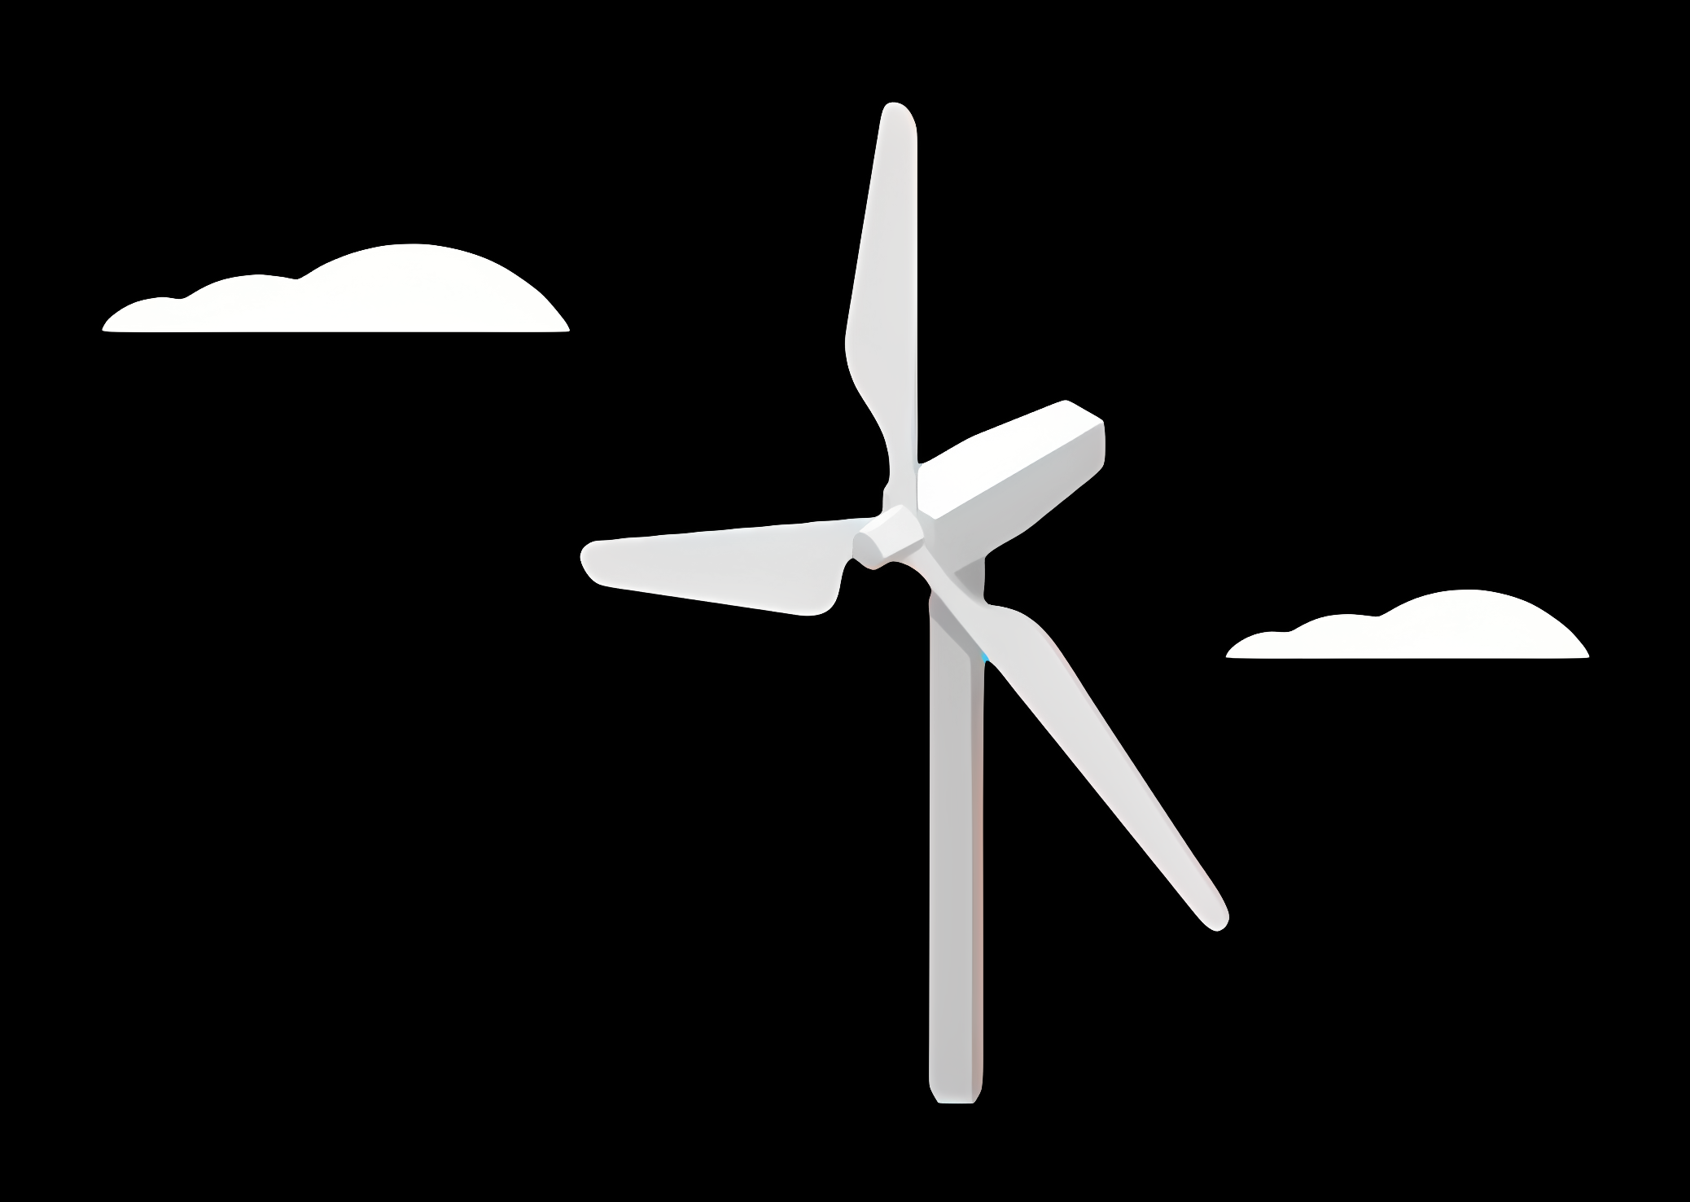
Weekly Presentation: Rotor Bearing System
Week number : 01
Date: 27/08/2025
Supervisor: Prof. Quell
Group members: Divyesh, Sreekanth, Sreehari, Jill

Slide 2
Content Overview
Introduction
Components to Design and its consideration
Types of Drivetrain System
Drivetrain System Shortlisted for WEC Syria
Types Rotor Bearing
References

Slide 3
Introduction
Rotor Bearing System (RBS) supports and allows rotation of the wind turbine rotor.
It transfers mechanical loads safely to the structure.
It’s part of the drivetrain: Rotor → Shaft → Bearings → Coupling → Gearbox → Generator.
Operates under harsh environmental conditions: temperature extremes, dust, humidity especially in SYRIA

Slide 4
Components to Design in RBS
Main Shaft – Connects rotor to gearbox
Bearings – Allow rotation, support loads
Bearing Housing – Encloses the bearing
Coupling – Transfers torque from shaft to gearbox
Flanges – Provide bolted connection interfaces

Slide 5
Design Considerations
Standards: They ensure safety, reliability, and compatibility. They give rules for how strong, durable, or precise a part must be.
Materials:
High fatigue strength to handle variable loads.
Resistance to corrosion (humid area).
Availability and cost-efficient
DIN EN 1563:2012-03 to select the suitable material specifications
Design Requirements:
Mainly life span ......(Min of 20 years)
Must handle: Deformations of rotor shaft, Angular misalignments, Standstill loads, Harsh environmental exposure
Shaft,Housing,Rotor locking disk | EN-GJS-***-** Cast iron
Rotor Bearing | Steel

Slide 6
Types of Drivetrain System
Configuration Type | Description | Typical Bearings Used | Key Advantages | Limitations
Modular | Bearings housed separately from gearbox or frame | Spherical roller bearings, cylindrical roller bearings | Easy installation, service-friendly | Limited axial load capacity, more components
Semi-integrated | One bearing housed separately, second integrated into gearbox | Spherical roller bearing + cylindrical roller bearings | Compact design, reduced parts | Complex integration, limited angle error compensation
Integrated | Main bearing integrated into gearbox or main frame | Slewing ring bearing, double row tapered roller bearing | Space-saving, cost-effective, high load capacity | Complex design, expensive, oil lubrication required
Axle Pin Mounting | Bearings mounted on axle pin inside hub housing | Tapered roller bearings, cylindrical roller bearings | High precision, simple installation | Requires stiff foundation, complex alignment

Slide 7
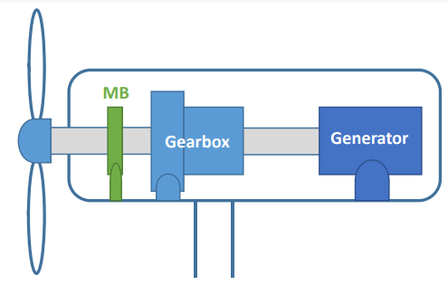
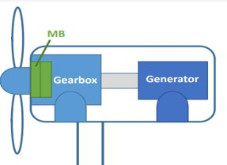
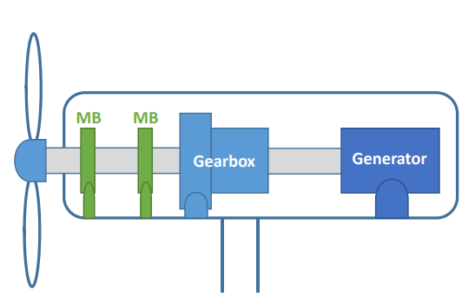
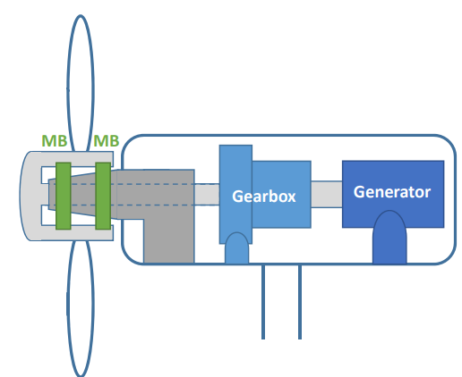
Types of Drivetrain System
Semi-integrated
Integrated
Modular
Axle Pin Mounting

Slide 8
Drivetrain system shortlisted
1. Integrated rotor bearing system combine the main bearing and other structural elements (like shaft or housing) into a single, optimised unit. You may have chosen this because:
Technical Advantages:
Compact design: Reduces the number of parts, leading to better alignment and load transfer.
Higher reliability: Fewer joints and interfaces mean lower chances of wear, misalignment, or failure.
Lower maintenance: Ideal for remote areas in Syria where frequent service might not be possible.
Improved performance: Optimised for stiffness, load paths, and fatigue life, which is crucial for high wind variations and turbulent inflow conditions.
Contextual Fit for Syria:
Energy reliability is critical: Syria has unstable energy infrastructure; integrated systems reduce the risk of downtime.
Difficult access to spare parts or skilled labour: Integrated units reduce the complexity of repairs and replacements.
Harsh environmental conditions (dust, heat): Fewer seals and joints help resist contamination and reduce lubrication problems.

Slide 9
2. Modular rotor bearing system use standardized parts that can be assembled, replaced, or scaled as needed. You may have suggested this because:
Technical Advantages:
Ease of transport and installation: Especially useful in areas where road or crane access is limited.
Flexibility in upgrades: Easier to scale the system or replace damaged modules without disturbing the whole structure.
Customizability: Bearings and housing can be adapted for specific rotor sizes or load conditions.
Contextual Fit for Syria:
Repairable and replaceable: In case of damage from wear, grid instability, or weather, parts can be swapped with ease.
Local assembly possible: Reduces need for specialized manufacturing and can support local job creation.
Cost-effective for smaller or distributed wind farms: Syria may need many smaller, local wind installations rather than one giant farm.

Slide 10
Suitability Comparison of different Drivetrains
Criteria | Integrated | Modular | Semi-Integrated | Axle Pin Mounting
Reliability | ✅ High | ✅ Moderate | ❌ Moderate | ❌ Low
Suitability for Syria | ✅ High | ✅ High | ❌ Low | ❌ Very Low
Maintenance | ✅ Low | ✅ Medium | ❌ Medium | ❌ High
Technical scalability | ✅ High | ✅ Medium-High | ❌ Medium | ❌ Very Low
Risk in harsh environments | ✅ Low | ✅ Medium | ❌ Medium-High | ❌ High

Slide 11
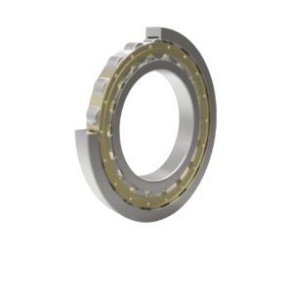
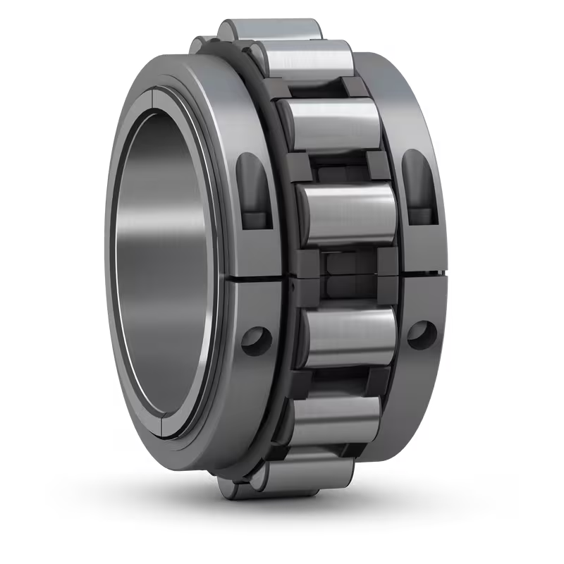
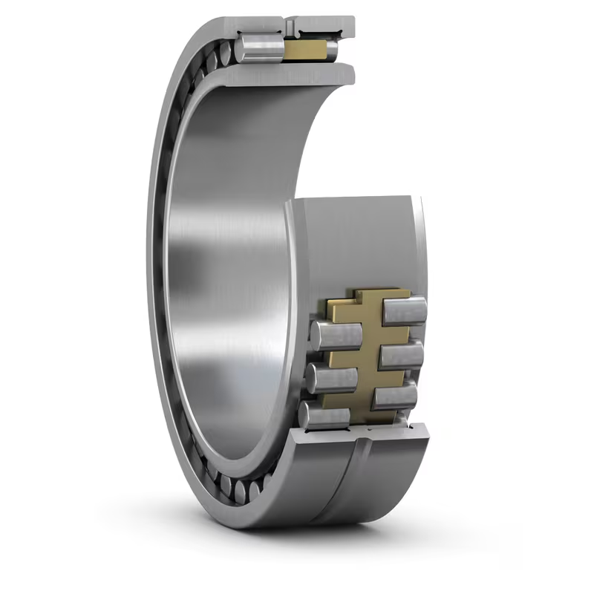
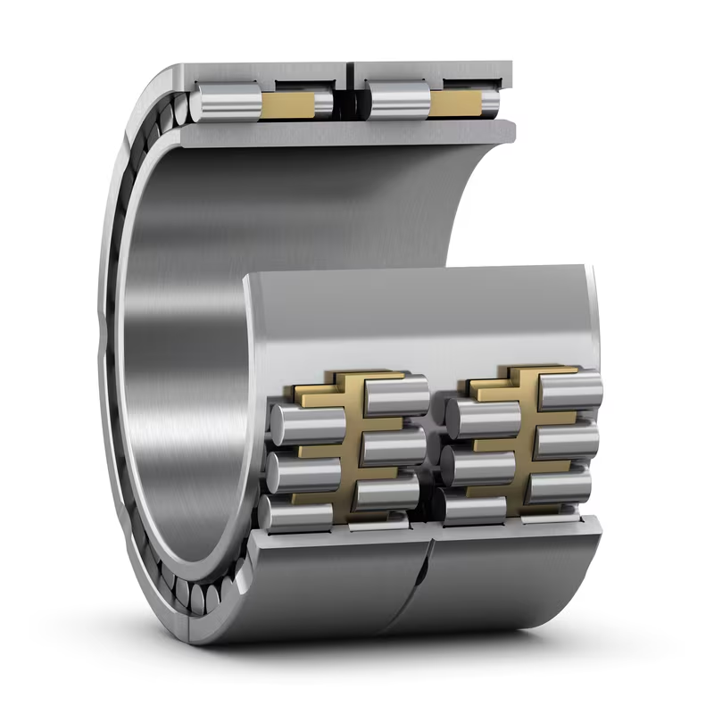
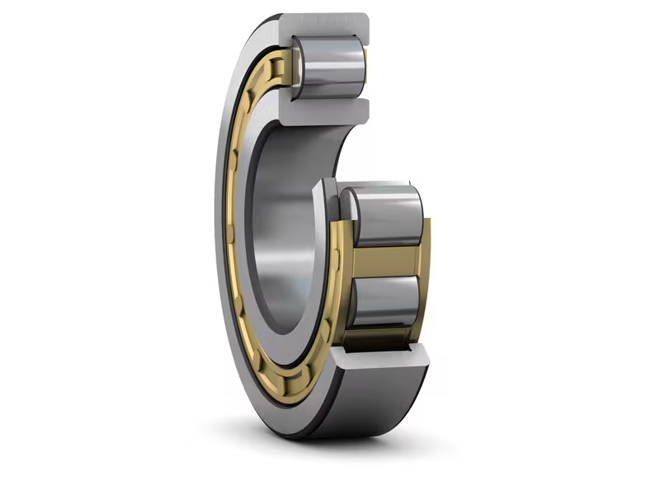
Types of Rotor Bearing
Cylindrical Roller Bearing (CRB)
High Radial Load Capacity
Low Friction Performance
High Precision
Often used as non-locating bearing in double designs.
Source-SKF

Slide 12
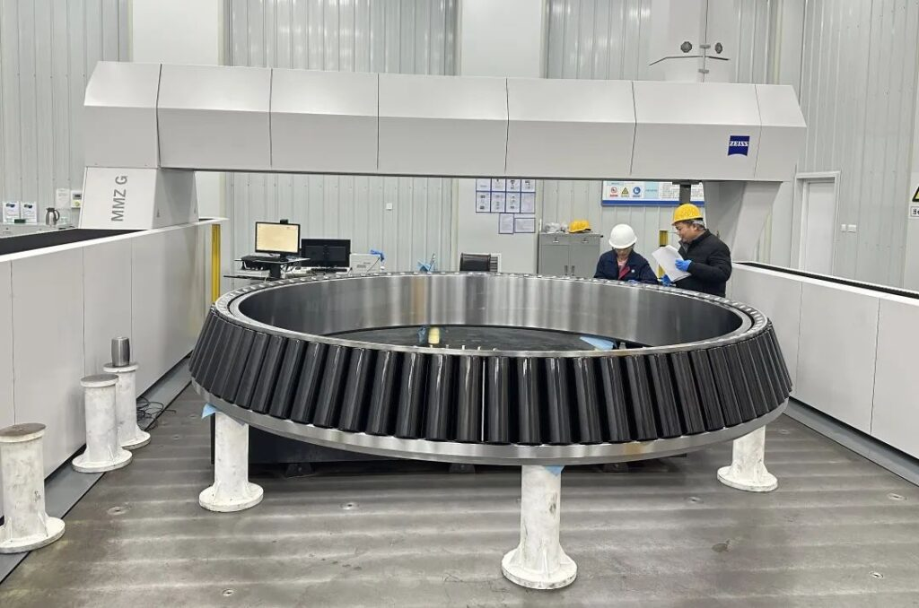
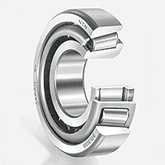
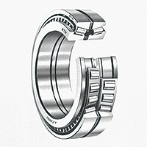
Tapered Roller Bearing (TRB)
Handles combined radial and axial loads.
Often used in two-bearing designs.

Slide 13
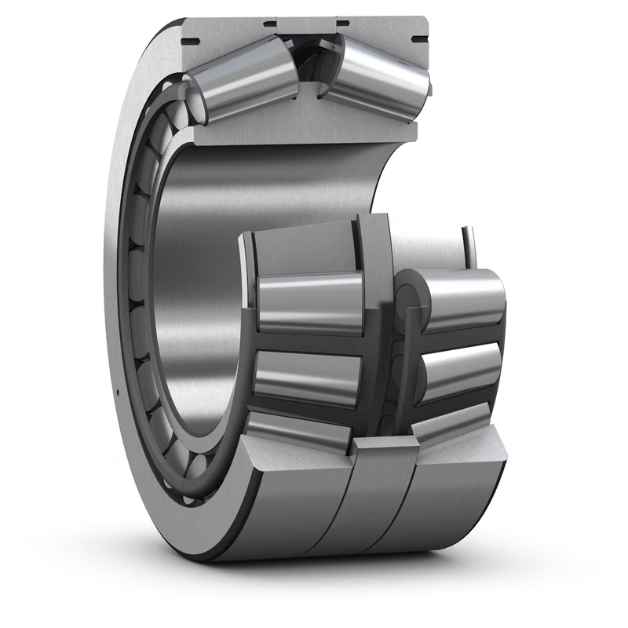
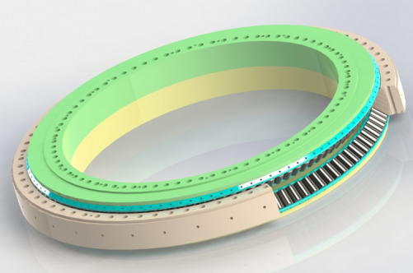
Double Row Tapered Roller Bearing (DRTRB)
High stiffness and compact design.
Suitable for integrated bearing housings.

Slide 14
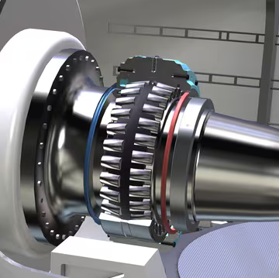
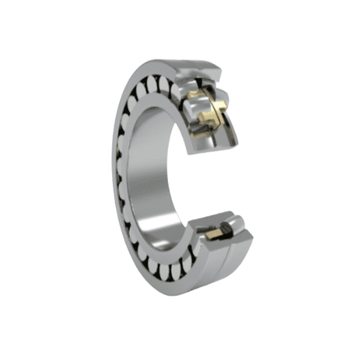
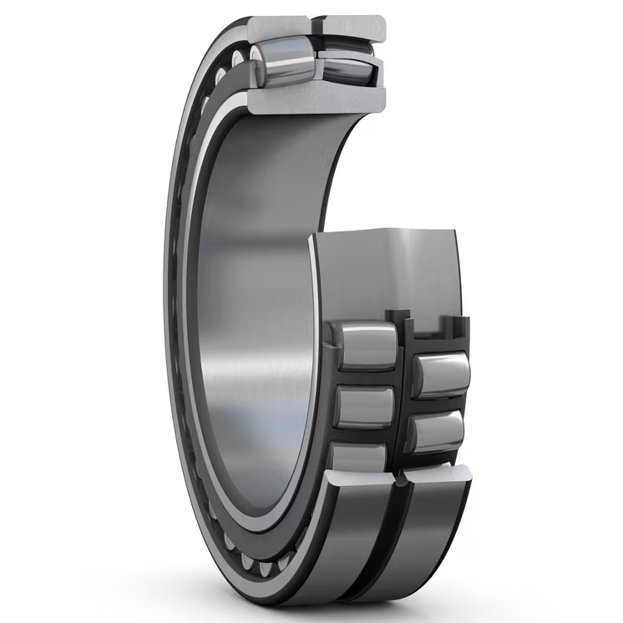
Spherical Roller Bearing (SRB)
Simultaneously withstands High Radial and Axial Loads
Self-Aligning Capability
Optimized Lubrication Design
Common in single-bearing designs.

Slide 15
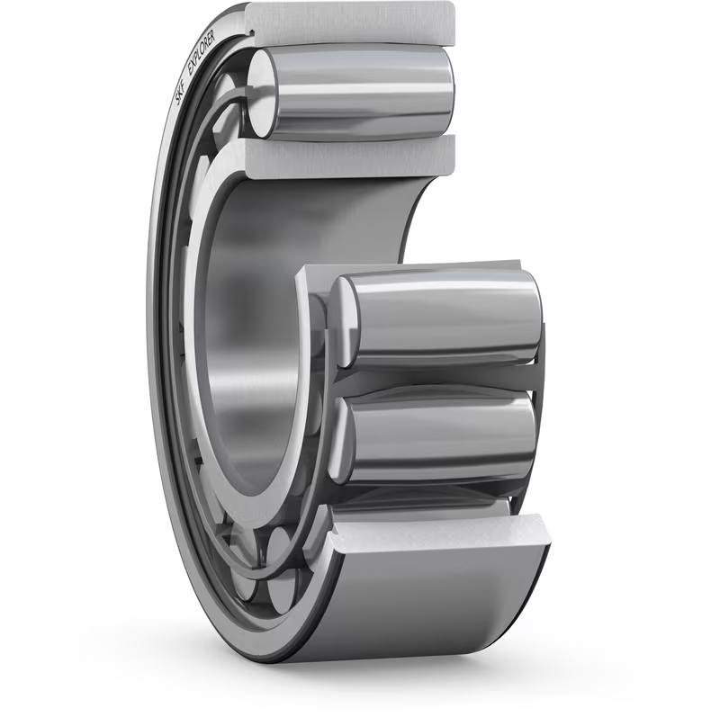
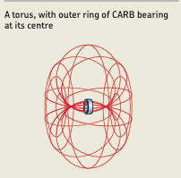
Toroidal Roller Bearing (CARB)
Combines misalignment and axial displacement tolerance.
Have one row of long, slightly barrel-shaped symmetrical rollers and torus-shaped raceway profiles .
They are non-locating bearings and accommodate exclusively radial loads.
often used to replace the non-locating spherical roller bearing in a locating/non-locating bearing arrangement.

Slide 16
Arrangements of Bearing
Arrangement Style | Description | Use Case
Floating | One bearing allows axial movement | Compensates for thermal expansion
Locating/Non-locating | One bearing fixed axially, other allows movement | Common in modular setups
Adjusted (O/X) | Bearings preloaded in face-to-face (X) or back-to-back (O) configuration | High precision, used in tapered or angular contact bearings

Slide 17
Bearing Short Listed
Selected Configuration
Pre-loaded tapered roller bearing in O-arrangement
2. Spherical Bearing

Slide 18
Supplier Details
Supplier identification in Syria is under process, but none have been located to date.

Slide 19
References
The Wind Power. “Syria - Wind farms.” The Wind Power Database, https://www.thewindpower.net/country_windfarms_en_123_syria.php
Amer, R., & Abou Hamed, F. (2012). Reality and prospects of wind power in Syria. Energy Procedia, 19, 55–62. https://doi.org/10.1016/j.egypro.2012.05.182
Terwey, J. T., Barcikowski, T., Lüneburg, B., Juretzki, B., Andary, F., & Habermehl, C. (2023). Cost Efficient Design of Wind Turbine Main Bearing Systems. In Conference for Wind Power Drives 2023 (CWD 2023), Aachen, Germany, March 21–22, 2023. RWTH Aachen University, Institute for Machine Elements and Systems Engineering. Available via ResearchGate
Terwey, J.T., Mendelin, J. Design-to-cost for TRB-TRB wind turbine main bearing systems. Forsch Ingenieurwes 89, 18 (2025). https://doi.org/10.1007/s10010-025-00790-6
Hart, E., Clarke, B., Nicholas, G., Kazemi Amiri, A., Stirling, J., Carroll, J., Dwyer-Joyce, R., McDonald, A., & Long, H. (2020). A review of wind turbine main bearings: design, operation, modelling, damage mechanisms and fault detection. Wind Energy Science, 5(1), 105–124. https://doi.org/10.5194/wes-5-105-2020
Prof. Peter Quell Lecture Notes

Slide 20
